Slide 1
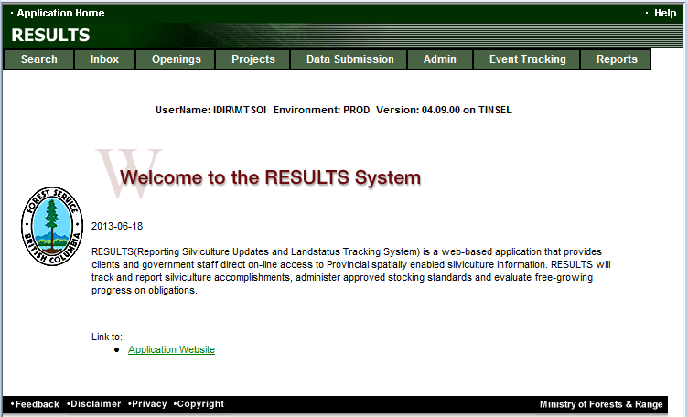
RESULTS Training
Core Module 3
Obligation Reporting
Submitting by ESF
Sept 2013

Slide 2
Learning Objectives
Business Guidelines
Guidance on Mandatory ESF
Online or ESF Matrix
Technical documentation references
Submission Components
  ESF Meta-data
  Opening definition
  Disturbance submission
  Silviculture submission
  Forest Cover submission
  Milestone submission
Technical Documentation-Forest Cover Submission Rules
Mandatory vs. Edit rules
Submission Process
Help resources

Slide 3
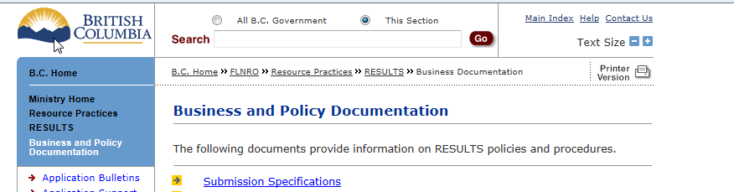
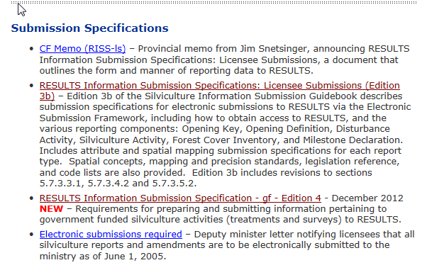
Business Guidance
http://www.for.gov.bc.ca/his/results/business.htm

Slide 4
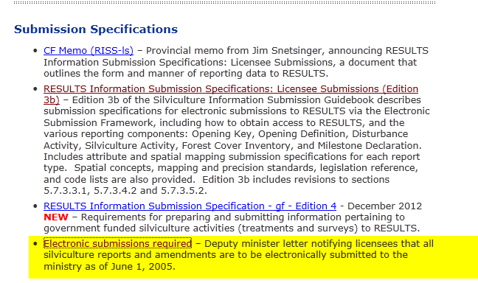
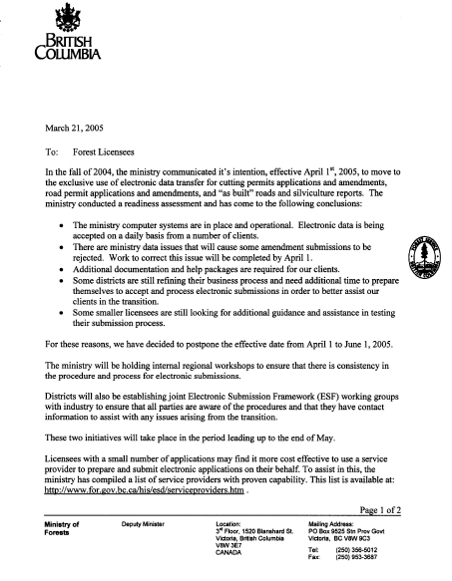
Mandatory ESF

Slide 5
Online or ESF Matrix
Submission Component | ESF | Online
\Opening Definition Tenure & Site Plan Information | Yes | No Opening and Standards Unit Spatial required
SU Modifications* | Yes | Conditional ESF where there is changes to Standards Unit (additions, deletions) or changes in spatial.
Disturbance | Yes | Yes
Silviculture Activity | Yes | Yes Mandatory ESF for government funded activities (FE, JS)
Forest Cover * | Yes | No Forest Cover Spatial required
Milestone | Yes | Yes
s.108 Application | No | Yes
* Any spatial requirements must be submitted by ESF

Slide 6
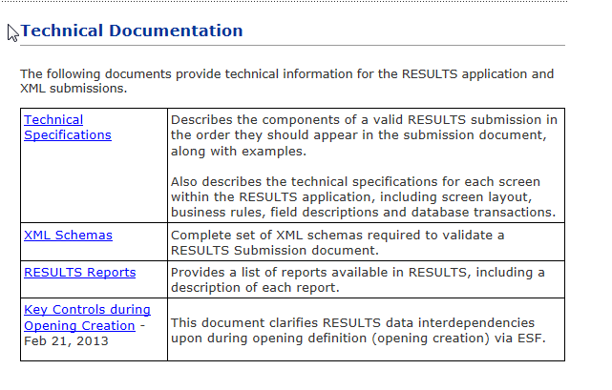
Technical Documentation References http://www.for.gov.bc.ca/his/results/techDocs.htm

Slide 7
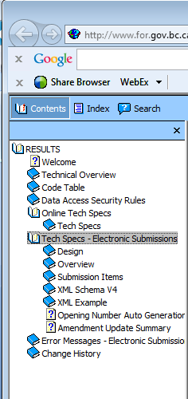
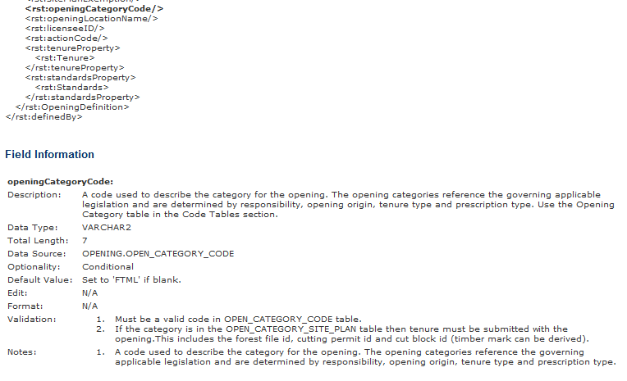
Technical Documentation ESF Schema References
http://www.for.gov.bc.ca/his/results/techDocs.htm
Tech Specs has ESF Reference with business rules and field specific edits.
Reference is by schema item.

Slide 8
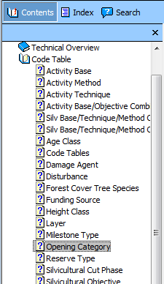
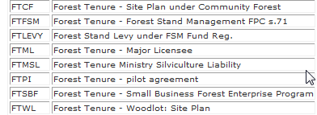
Technical Documentation Codelists
http://www.for.gov.bc.ca/his/results/techDocs.htm

Slide 9
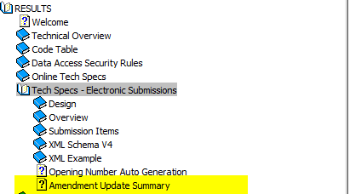
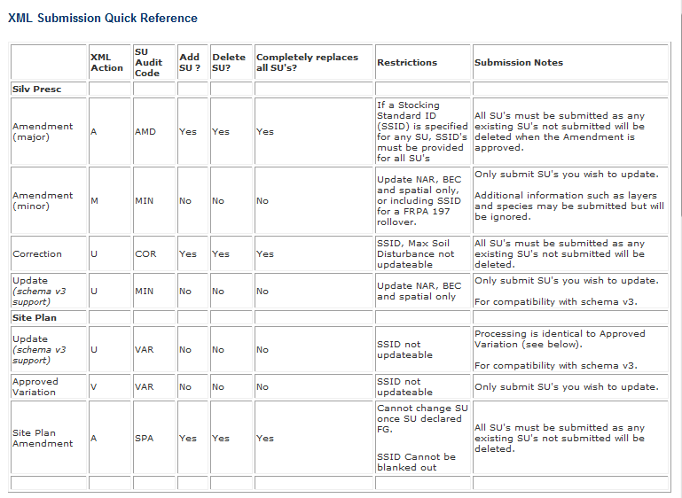
Technical Documentation SU Modifications Cheatsheet
http://www.for.gov.bc.ca/his/results/techDocs.htm
Helps explain setup for ESF portion
“A” and “V” actions with inclusion or omission of SU implies addition or removal of SUs!

Slide 10
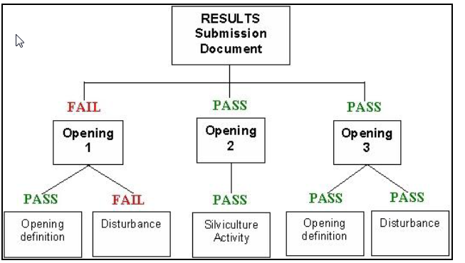
Submission Components - ESF Submission
ESF Submission can be set up by individual opening or
can be batched for multiple openings.
If new to RESULTS ESF – suggest do it individually to become
familiar with process and requirements

Slide 11

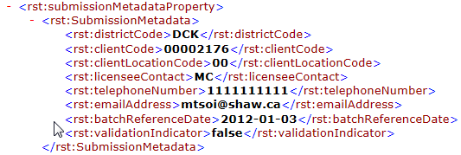
Submission Components - ESF Submission Metadata
ESF Submission Metadata
  Identifies the submitter
RESULTS Submission Metadata
  Identifies the Licensee
  Indicates Validate or not
Note this info is automatically provided via BCeID for online entries

Slide 12
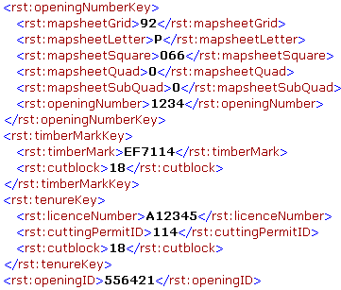
Submission Components - Opening Definition
Opening Key
  Identifies the opening to which the submission belongs
  Can be any of
    Opening Number
    TimberMark/Blk*
    Licence/CP/Blk*
    Opening ID
*These keys link to FTA and bring tenure data forward to RESULTS. Must use one of these keys for the first submission.

Slide 13
Submission Components - Opening Definition
Opening Definition
  Used to:
    Create new openings
    Update existing openings
    Propose amendments to existing openings
    Propose cutblocks to amalgamate into a single opening
  Identifies:
    Site Plan information including
      Previous stand information
      Standard regime (standard id)
      Governing tenure
      Spatial location opening/SUs
  Key Links:
    FTA for Tenure Data
    Data shipped to GeoBC

Slide 14
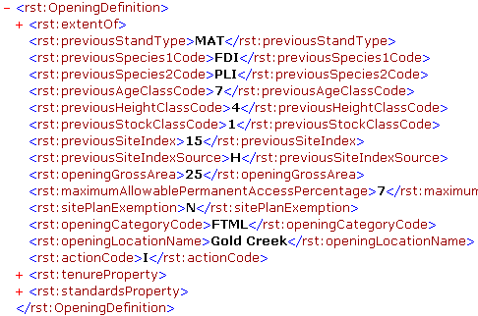
Submission Components - Opening Definition
Opening Definition – 3 components
  Opening data
  Tenure data
  SU data
Action Codes
  I – Insert (New openings)
  U – Update
  A – Amendments
  M – Minor Amendments
  V – Approved Variations
  O – Opening Amalgamation

Slide 15
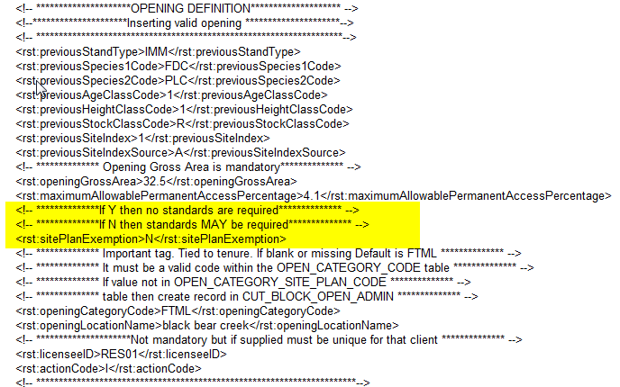
SU Requirement & Role of Site Plan Exempt Ind
http://www.for.gov.bc.ca/his/results/Key%20Controls%20during%20Opening%20Creation-Feb%2021%202013.pdf
All New Openings via ESF must have at least ONE Standards Unit in the Opening Definition
Rst: sitePlanExempt is an indicator used by RESULTS to determine if Standards Unit is:
  a silviculture prescription “Y” – full stocking standards provided ; OR
  a site plan “N” – an approved standards regime ID authorized by submitter is provided.

Slide 16
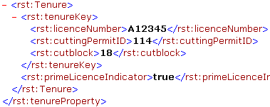
Submission Components - Opening Definition
Opening Definition – 3 components
  Opening data
  Tenure data
  SU data
RESULTS allow multi-cutblock openings.
Prime Licence Indicator is set to true if only one cutblock is assigned to one opening.
If there is a requirement to have more than one cutblock associated with an opening, one must be true, all other cutblocks must be False (non-prime).

Slide 17
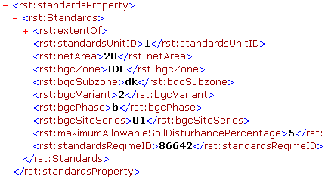
Submission Components - Opening Definition
Opening Definition – 3 components
  Opening data
  Tenure data
  SU data
Spatial data for Standard Units is required
Standards Regime must be approved for use for submitting client and org unit unless Ministry default.
  Key Links:
    FTA validation
    GeoBC
    Derives FSP ID if Standard Regime ID exists in FSPTS

Slide 18
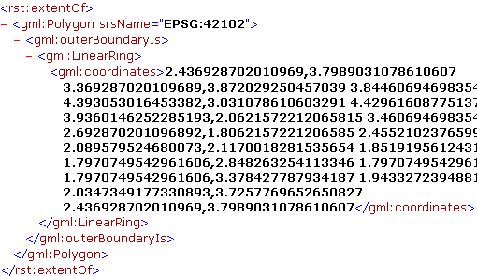
Submission Components - Opening Definition
Opening Definition – 3 components
  Opening data
  Tenure data
  SU data
    Spatial Data
Spatial data for Standard Units is required

Slide 19
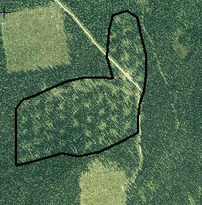
Submission Components - Opening Definition
Opening Boundary
SU Boundary
Example spatial information for an Opening Definition

Slide 20
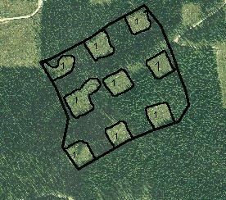
Submission Components - Opening Definition
Opening Boundary
SU Boundary
Example spatial information for an Opening Definition

Slide 21

Submission Components - Disturbance Submission
  Used to:
    Create new Disturbances (“I”- Insert)
    Update existing Disturbances (“U”- Update)
  Identifies:
    Disturbance code
    Silviculture System
    Harvest Start and Complete Dates
    Area disturbed
    Disturbance Activity Map is optional
  Key Links
    Updates FTA for Harvest Area, Dates, and cutblock status,
    GeoBC
    Used as trigger for VRIMS to indicate depletion

Slide 22
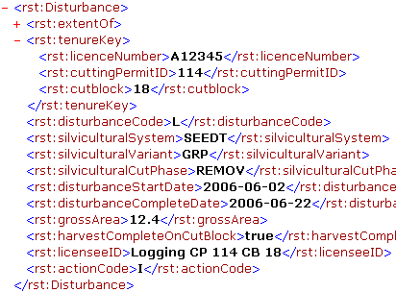
Submission Components - Disturbance Submission
Multiple Disturbance Submissions per opening are required where there is more than one tenure governing an opening, and/or there are different silviculture systems within the same opening

Slide 23

Submission Components - Disturbance Submission
Gross area – NPNAT - Undisturbed Reserves = Disturbance Area
Newly created roads are included in the disturbance area

Slide 24
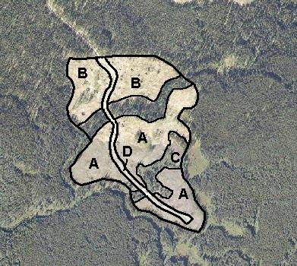
Submission Components - Disturbance Submission
Gross area – NPNAT - Undisturbed Reserves = Disturbance Area
Newly created roads are included in the disturbance area

Slide 25

Submission Components
- Silviculture Activity Submission
  Used to:
    Create new Activities (“I”-Insert)
    Update existing Activities (“U”-Update)
  Identifies:
    Silviculture Treatments
    Treatment Date
    Area treated
    Spatial Location*
    * Silviculture Activity Map is optional (unless specified in RISS)
  Key Links
    GeoBC
    SPAR (species and seedlot validation)

Slide 26
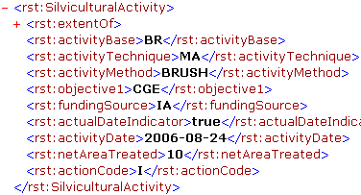
Submission Components
- Silviculture Activity Submission
Silviculture Activities
  Site prep
  Planting
  Brushing
  Juvenile spacing
  Fertilization
  Pruning
  actDateIndicator
  True – completed activity
  False – planned activity

Slide 27
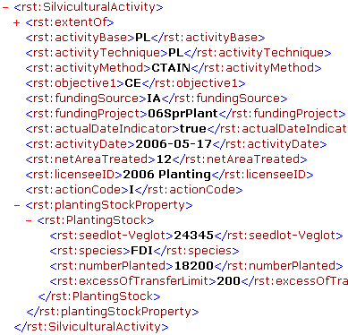
Submission Components
- Silviculture Activity Submission
Planting Activity
  Requires additional information associated with the planted trees
  Seedlot Number is validated against SPAR to confirm Seedlot number exists and species matches seedlot number

Slide 28
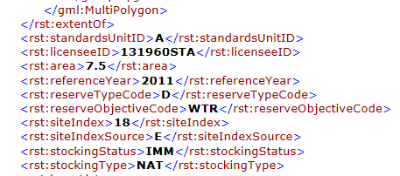
Submission Components - Forest Cover Submission
Forest Cover – 4 main data components
  Polygon Data
  Layer Data
    Tree Species
    Damage Agent
  NonMappable Component
  Spatial
Forest Cover Submission can occur only when a Disturbance Report exists in the ESF submission or if it exists for the opening.
*Spatial data for forest cover polygons is required
If submitting for reserve, important to understand Treed Retention Reporting requirements: http://www.for.gov.bc.ca/his/results/Forest_Cover_Retention_Submissions.pdf

Slide 29
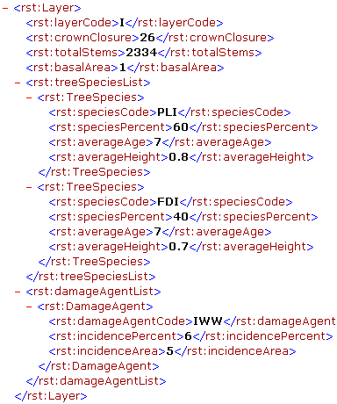
Submission Components - Forest Cover Submission
Forest Cover – 4 main data components
  Polygon Data
  Layer Data
    Tree Species
    Damage Agent
  NonMappable Component
  Spatial
Forest Cover is a complete replacement.
Forest Cover Submission must be submitted for the entire opening even if only a partial of the opening has underwent forest cover change.
Partial forest cover is not allowed and will create spatial data gaps!

Slide 30
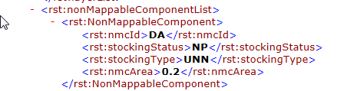
Submission Components - Forest Cover Submission
Forest Cover – 4 main data components
  Polygon Data
  Layer Data
    Tree Species
    Damage Agent
  NonMappable Component
  Spatial
Forest Cover is a complete replacement.
Forest Cover Submission must be submitted for the entire opening even if only a partial of the opening has underwent forest cover change.
Partial forest cover is not allowed and will create spatial data gaps!

Slide 31
Submission Components - Forest Cover Submission
Polygon | Description | Standards Unit | Area (ha)
A | Cutover | 1 | 10.0
B | Mature |  | 35.0
C | NP UNN |  | 5.0

Slide 32
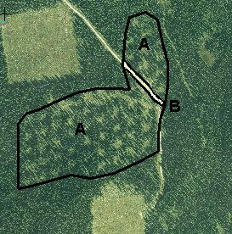
Submission Components - Forest Cover Submission
C
Polygon | Description | Standards Unit | Area (ha)
A | Clearcut | 1 | 30.0
B | Seedtree | 2 | 20.0
C | Reserves |  | 10.0
D | NP UNN |  | 3.0
Polygon | Description | Standards Unit | Area (ha)
A | Variable Retention | 1 | 20.0
B | NP UNN |  | 5.0

Slide 33
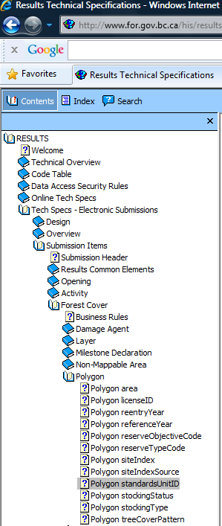
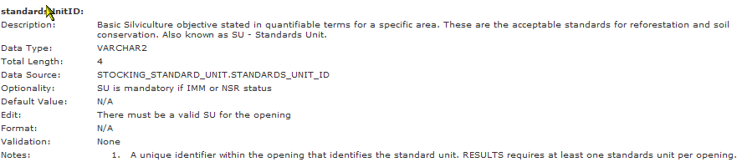
Submission Components -
Forest Cover Submission
Forest Cover contains many validation rules and inter-data dependencies to ensure data completeness where expected.
Mandatory requirements are explained in the RISS-ls and also in the ESF technical specifications.

Slide 34
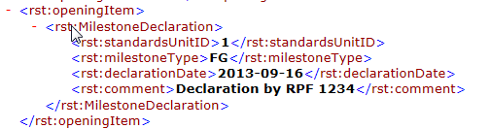
Submission Components - Milestone
Milestone Declaration
  StandardsUnit ID
  Milestone Type
  Declaration Date
  Comment (optional) but useful for reference of RFP performing declaration, s.97.1, s.108 relief of obligation, or any useful notes pertaining to declaration
Note that free growing forest cover must be submitted prior to free growing declaration (not system’s enforced but required by legislation)

Slide 35
Mandatory legal requirement vs. Edit Checks
RESULTS Information Submission Specification document provides information on mandatory data requirements.
RESULTS will provide some rudimentary system’s checks for data quality and data dependencies but cannot check for all legal requirements due to complexity and requirement for interpretation.
It is responsibility of the submitter to ensure that the data submitted is consistent with legal requirements.
Any system’s edit checks are described in the RESULTS Technical Specifications webpage.

Slide 36
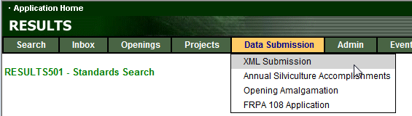
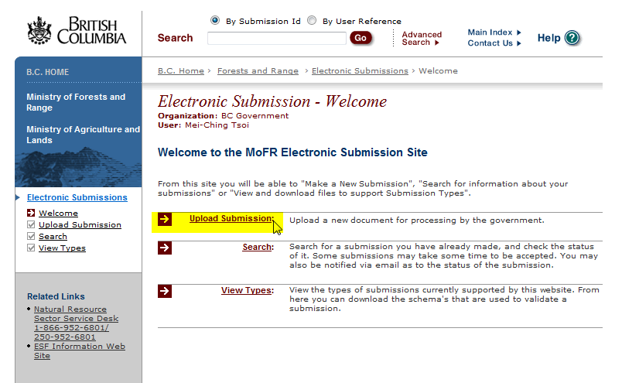
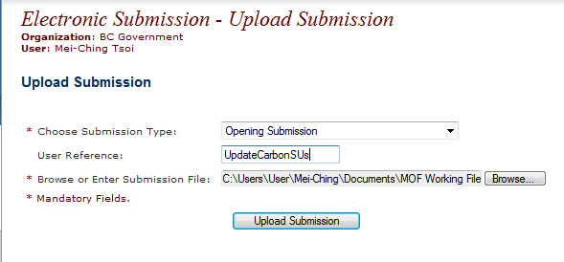
Submission Process
Vendor product s often have integrated ESF submission to RESULTS ESF . This step may not be required
Must specify Submission Type: Opening Submission

Slide 37
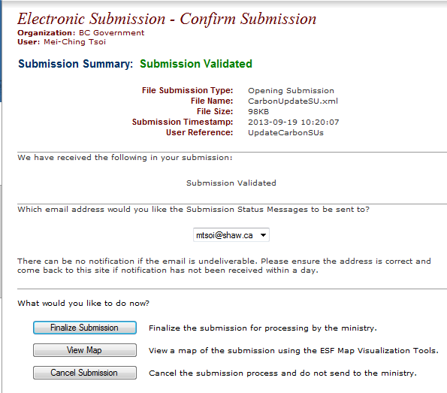
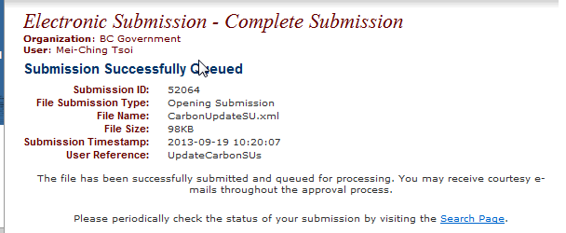
Submission Process

Slide 38
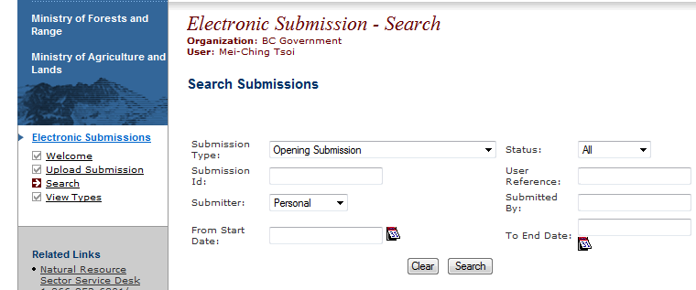
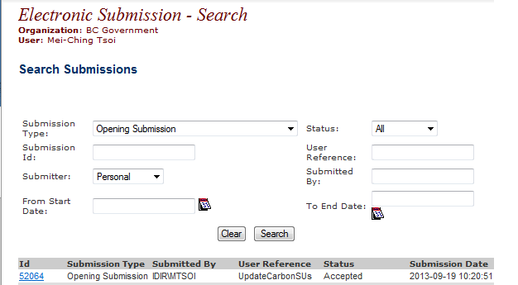
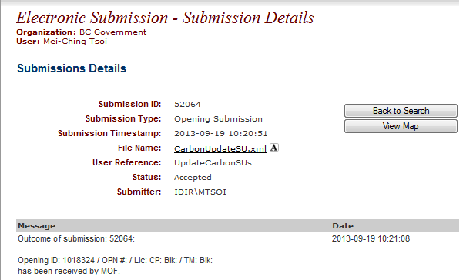
Submission Process
Must specify Submission Type: Opening Submission
Confirmation of Pending, Acceptance, or Rejection
Ability to reference XML submitted and any submission errors if rejected.

Slide 39
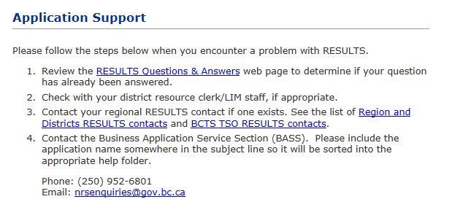
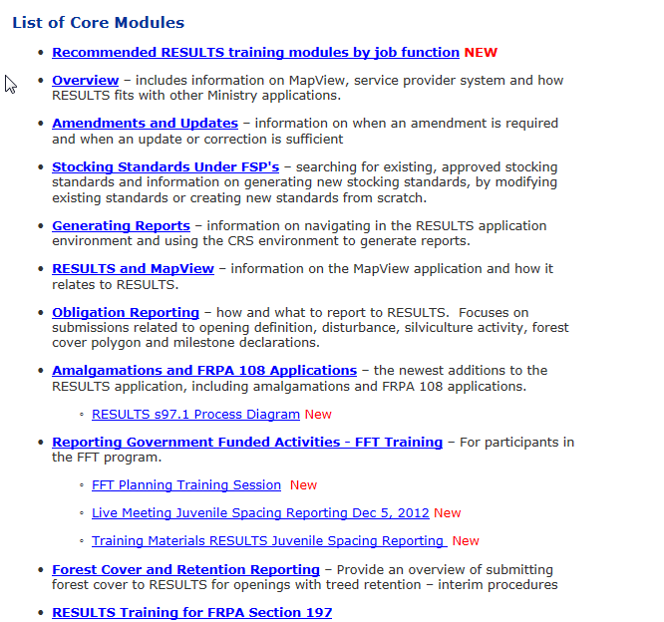
Help Resources
http://www.for.gov.bc.ca/his/results/support.htm
http://www.for.gov.bc.ca/his/results/training/index.htm
E-Stand Enhancement

